Slide 1
Fragment
Prepare By: You Tithrottanak

Slide 2
Framents
New in Android 3.0 (Honeycomb, API 11)
Usable in previous versions with compatibility library
Intended to reuse layouts between tablets and phones
But usable for many more...
Definition:
A Fragment represents a behavior or a portion of user interface in an Activity.
Prepare By: You Tithrottanak

Slide 3
Interaction with Activities
A fragment is a modular section of an activity, which has its own lifecycle...
But, a fragment's lifecycle is directly affected by the host activity's lifecycle
Activity paused: fragments paused
Activity destroyed: fragments destroyed
Activity running: fragments can have different states
Prepare By: You Tithrottanak

Slide 4
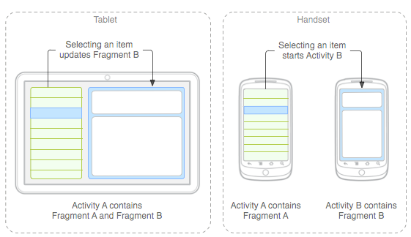
Design
Prepare By: You Tithrottanak

Slide 5
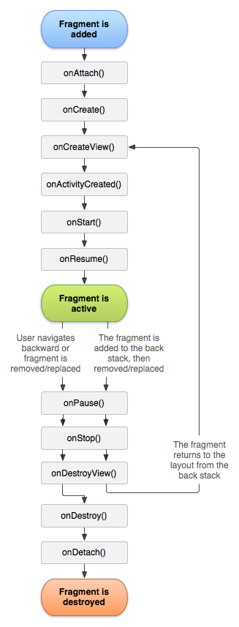
Fragment Lifecycle
onCreate()
The system calls this when creating the fragment.
onCreateView()
The system calls this when it's time for the fragment to draw its user interface for the first time.
onPause()
The system calls this method as the first indication that the user is leaving the fragment (though it does not always mean the fragment is being destroyed).
Prepare By: You Tithrottanak

Slide 6
Creating a Fragment
public static class ExampleFragment extends Fragment { @Override public View onCreateView(LayoutInflater inflater, ViewGroup container, Bundle savedInstanceState) { // Inflate the layout for this fragment return inflater.inflate(R.layout.example_fragment, container, false); } }
View inflate (int resource, ViewGroup root, boolean attachToRoot)
int resource: The resource ID of the layout you want to inflate.
root: Parent of the inflated layout
attachToRoot: A boolean indicating whether the inflated layout should be attached to the ViewGroup
Prepare By: You Tithrottanak

Slide 7
Adding a fragment to an activity
<?xml version="1.0" encoding="utf-8"?>
<LinearLayout xmlns:android="http://schemas.android.com/apk/res/android" android:orientation="horizontal" android:layout_width="match_parent" android:layout_height="match_parent"> <fragment android:name="org.catdroid.fragments.FirstFragment" android:id="@+id/firstFragment" android:layout_weight="1" android:layout_width="match_parent" android:layout_height="match_parent" /> <fragment android:name="org.catdroid.fragments.SecondFragment" android:id="@+id/secondFragment" android:layout_weight="2" android:layout_width="match_parent" android:layout_height="match_parent" /> </LinearLayout>
Prepare By: You Tithrottanak

Slide 8
Managing fragments
Create a Fragment Transaction (from Activity!)
FragmentManager fragmentManager = getFragmentManager(); FragmentTransaction fragmentTransaction = fragmentManager.beginTransaction();
b) Establish transaction properties (transitions!)
Fragment newFragment = new ExampleFragment(); transaction.replace(R.id.fragment_container, newFragment);
transaction.addToBackStack(null);
transaction.addToBackStack(null); transaction.setCustomAnimations(R.anim.enter, R.anim.exit, R.anim.pop_in, R.anim.pop_out);
c) Commit!
transaction.commit();
Prepare By: You Tithrottanak

